Slide 1

BLS Resuscitation
CHAPTER 14

Slide 2
National EMS Education Standard Competencies
Shock and Resuscitation
Applies a fundamental knowledge of the causes, pathophysiology, and management of shock, respiratory failure or arrest, cardiac failure or arrest, and postresuscitation management.
Notes:
National EMS Education Standard Competencies
Shock and Resuscitation
Applies a fundamental knowledge of the causes, pathophysiology, and management of shock, respiratory failure or arrest, cardiac failure or arrest, and postresuscitation management.

Slide 3
Introduction
The principles of basic life support (BLS) were introduced in 1960.
Specific techniques have been reviewed and revised regularly.
The most recent review (2020) was conducted by the International Liaison Committee on Resuscitation (ILCOR).
Notes:
Lecture Outline
I. Introduction
A. The principles of basic life support (BLS) were introduced in 1960.
B. Since then, the specific techniques have been reviewed and revised regularly.
C. The most recent review (2020) was conducted by the International Liaison Committee on Resuscitation (ILCOR).

Slide 4
Elements of BLS (1 of 8)
Noninvasive emergency life-saving care
Used to treat medical conditions including:
  Airway obstruction
  Respiratory arrest
  Cardiac arrest
Notes:
Lecture Outline
II. Elements of BLS
A. BLS is noninvasive emergency life-saving care that is used to treat medical conditions, including:
1. Airway obstruction
2. Respiratory arrest
3. Cardiac arrest

Slide 5
Elements of BLS (2 of 8)
Focus is on the ABCs.
  Airway (obstruction)
  Breathing (respiratory arrest)
  Circulation (cardiac arrest or severe bleeding)
Notes:
Lecture Outline
B. Focus is on the ABCs
1. Airway (obstruction)
2. Breathing (respiratory arrest)
3. Circulation (cardiac arrest or severe bleeding)

Slide 6
Elements of BLS (3 of 8)
Ideally, only seconds should pass between the time you recognize a patient needs BLS and the start of treatment.
  Permanent brain damage is possible if brain is without oxygen for 4 to 6 minutes.
Notes:
Lecture Outline
C. If the patient is in cardiac arrest, then a CAB sequence (compressions, airway, breathing) is used because chest compressions are essential and must be started as quickly as possible.
D. Only seconds should pass between the time you recognize that a patient needs BLS and the start of treatment.
1. Permanent brain damage is possible if brain is without oxygen for more than 4 to 6 minutes.

Slide 7
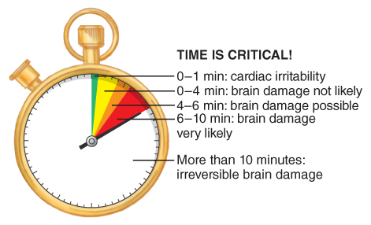
Elements of BLS (4 of 8)
FIGURE 14-2 Time is critical for patients who are not breathing. If the brain is deprived of oxygen for 4 to 6 minutes, brain damage is possible.
© Jones & Bartlett Learning.
Notes:
The figure on this slide illustrates the concept that time is critical for patients who are not breathing. If the brain is deprived from oxygen for more than 4 to 6 minutes, brain damage is possible.

Slide 8
Elements of BLS (5 of 8)
Cardiopulmonary resuscitation (CPR)
  Reestablishes circulation and artificial ventilation in a patient who is not breathing and has no pulse
Notes:
Lecture Outline
E. Cardiopulmonary resuscitation (CPR)
1. Reestablishes circulation and artificial ventilation in a patient who is not breathing and has no pulse

Slide 9
Elements of BLS (6 of 8)
CPR steps
  Restore circulation (perform chest compressions).
  Open the airway.
  Restore breathing (provide rescue breathing).
Notes:
Lecture Outline
2. CPR steps:
a. Restore circulation by performing high-quality chest compressions to circulate the blood.
b. Open the airway.
c. Restore breathing by providing rescue breathing.
i. Administer 2 breaths, each over 1 second, while visualizing for chest rise.

Slide 10
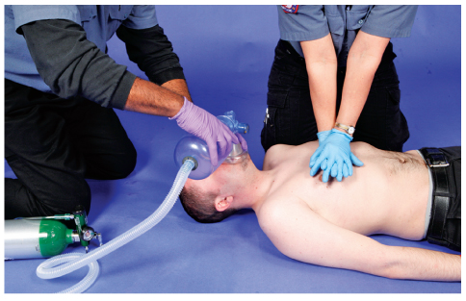
Elements of BLS (7 of 8)
FIGURE 14-3 You must quickly identify patients in respiratory and/or cardiac arrest so that BLS measures can begin immediately.
© Jones & Bartlett Learning. Courtesy of MIEMSS.
Notes:
The figure on this slide demonstrates two EMS providers performing CPR.

Slide 11
Elements of BLS (8 of 8)
BLS differs from advanced life support (ALS).
ALS involves:
  Cardiac monitoring
  Intravenous fluids and medications
  Advanced airway adjuncts
Notes:
Lecture Outline
F. BLS differs from advanced life support (ALS), which involves advanced procedures such as:
1. Cardiac monitoring
2. Administration of intravenous (IV) fluids and medications
3. Use of advanced airway adjuncts
G. When done correctly, BLS can maintain life for a short time until ALS measures can be started.

Slide 12
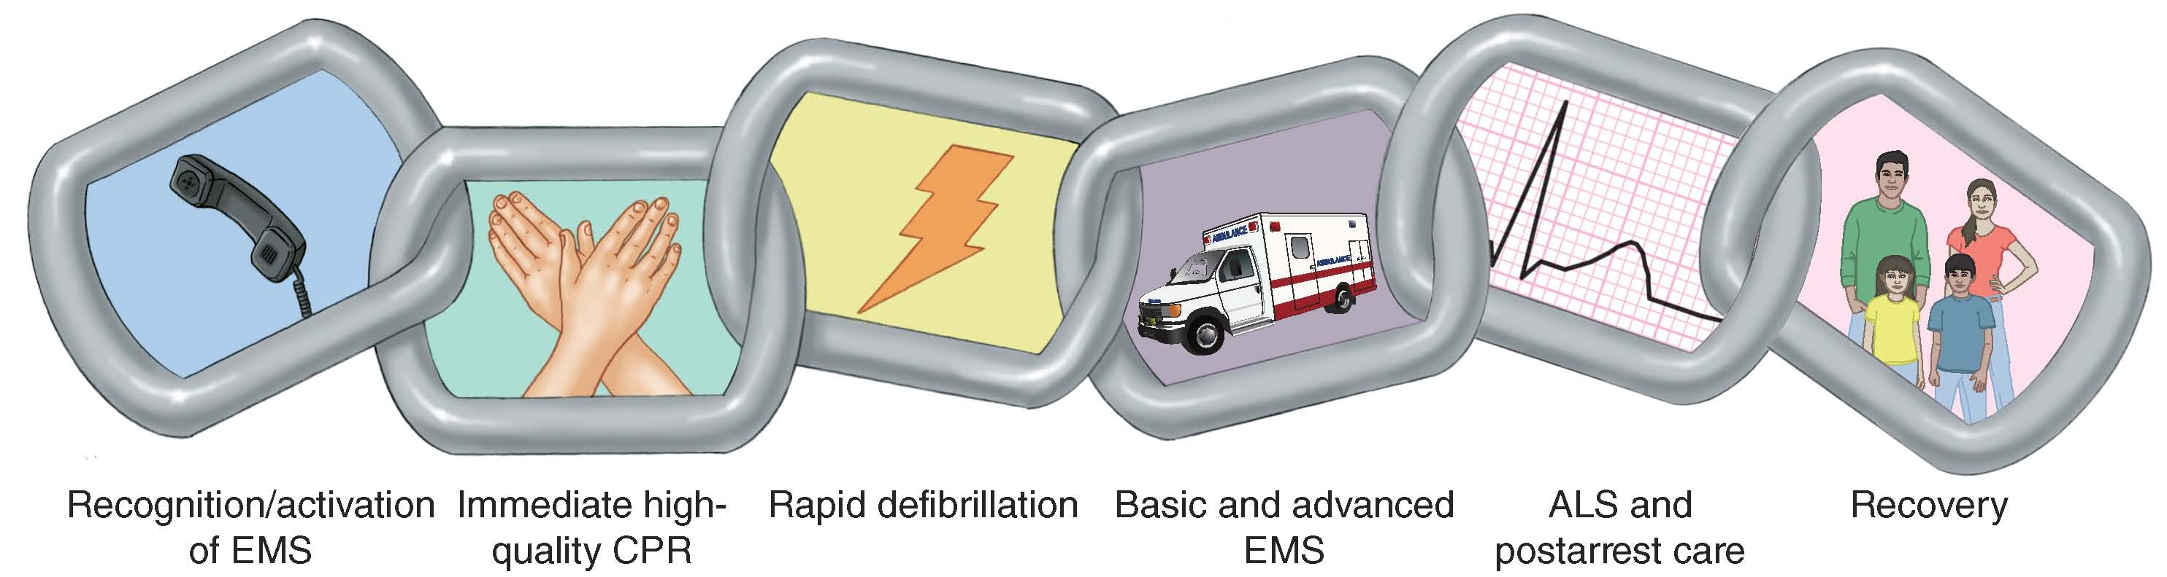
The System Components of CPR (1 of 2)
FIGURE 14-4 The six links of the chain of survival.
Data from the American Heart Association.
Notes:
The figure on this slide illustrates the six links of the chain of survival.

Slide 13
The System Components of CPR (2 of 2)
AHA chain of survival
  Recognition and activation of the emergency response system
  Immediate, high-quality CPR
  Rapid defibrillation
  Basic and advanced emergency medical services
  ALS and post-arrest care
  Recovery
Notes:
Lecture Outline
III. The System Components of CPR
A. Chain of survival
1. The American Heart Association (AHA) chain of survival:
a. Recognition and activation of the emergency response system
b. Immediate, high-quality CPR
c. Rapid defibrillation
d. Basic and advanced emergency medical services
e. Advanced life support and post-arrest care
f. Recovery
B. If any one of the links in the chain is absent, the patient is more likely to die.

Slide 14
Assessing the Need for BLS (1 of 3)
Always begin by surveying the scene.
Complete primary assessment as soon as possible.
  Evaluate ABCs.
Determine unresponsiveness.
  Should take less than 10 seconds
Notes:
Lecture Outline
IV. Assessing the Need for BLS
A. Always begin by surveying the scene:
B. Complete the primary assessment as soon as possible in order to evaluate the patient’s ABCs.
1. First step is determining unresponsiveness:
a. A responsive patient does not need CPR.
b. An unresponsive patient may or may not need CPR.
2. This step should take no more than 10 seconds.

Slide 15
Assessing the Need for BLS (2 of 3)
Basic principles of BLS are same for infants, children, and adults.
Although cardiac arrest in adults usually occurs before respiratory arrest, the reverse is true for infants and children.
Notes:
Lecture Outline
C. The basic principles of BLS are the same for infants, children, and adults.
D. Although cardiac arrest in adults usually occurs before respiratory arrest, the reverse is true in infants and children.

Slide 16
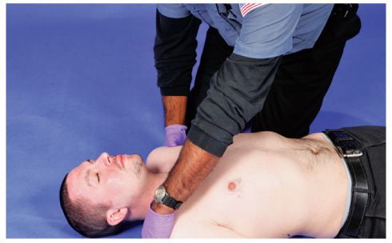
Assessing the Need for BLS (3 of 3)
FIGURE 14-5 Assess an unresponsive patient by first attempting to rouse him or her by tapping on the shoulder.
© Jones & Bartlett Learning. Courtesy of MIEMSS.
Notes:
The figure on this slide demonstrates how to assess an unresponsive patient by first attempting to rouse him or her by tapping on the shoulder.

Slide 17
Automated External Defibrillation (1 of 3)
Vital link in the chain of survival
Should be applied to cardiac arrest patients as soon as available
If you witness cardiac arrest, begin CPR and apply the AED as soon as it is available.
Notes:
Lecture Outline
V. Automated External Defibrillation
A. AED use is a vital link in the chain of survival.
B. The AED should be applied to a cardiac-arrest patient as soon as available.
C. If you witness cardiac arrest, begin CPR and apply the AED as soon as available.

Slide 18
Automated External Defibrillation (2 of 3)
Children
  Apply after first five cycles of CPR.
  Use pediatric-sized pads and dose-attenuating system.
    If neither is available, then use an AED with adult-sized pads with anterior-posterior placement.
Notes:
Lecture Outline
D. AED use in children
1. Apply after the first five cycles of CPR.
2. Use pediatric-sized pads and dose-attenuating system. If neither is available, then use an AED with adult-sized pads with anterior-posterior placement.

Slide 19
Automated External Defibrillation (3 of 3)
Special situations
  Pacemakers and implanted defibrillators
  Wet patients
  Transdermal medication patches
Notes:
Lecture Outline
E. Special situations
1. Pacemakers and implanted defibrillators
a. Place electrodes at least 1 inch (2.5 cm) away from the device.
2. Wet patients
a. If the patient is in water, pull the patient out and dry the skin before attaching the AED pads.
b. If the patient is in a small puddle of water or in the snow, the AED can be used, but the patient’s chest should be dried as much as possible.
3. Transdermal medication patches
a. Remove the patch and wipe the skin to remove any residue prior to attaching the AED pad.

Slide 20
Positioning the Patient
For CPR to be effective, patient must be supine on firm, flat surface.
Must be enough space for two rescuers to perform CPR
Log roll patient onto long backboard.
Notes:
Lecture Outline
VI. Positioning the Patient
A. For CPR to be effective, the patient must be lying supine on a firm, flat surface.
1. Ensure enough space around the patient for two rescuers to perform CPR.
2. If possible, log roll the patient onto a long backboard.

Slide 21
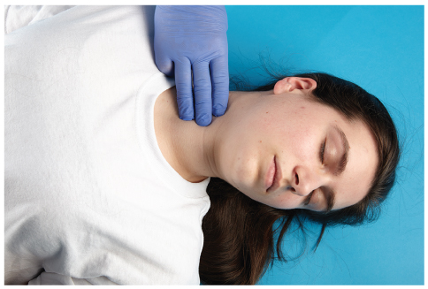
Check for Breathing and a Pulse (1 of 5)
Quickly check for breathing and a pulse.
  Visualize the chest for signs of breathing.
  Palpate for a carotid pulse.
FIGURE 14-6 Feel for the carotid artery by locating the larynx, then slide your index and middle fingers toward one side. You can feel the pulse in the groove between the larynx and sternocleidomastoid muscle.
© Jones & Bartlett Learning. Courtesy of MIEMSS.
Notes:
Lecture Outline
VII. Check for Breathing and a Pulse
A. Quickly check for breathing and a pulse.
1. These assessments can occur simultaneously and take no longer than 10 seconds total.
a. Visualize the chest for signs of breathing.
b. Palpate for a carotid pulse.

Slide 22
Check for Breathing and a Pulse (2 of 5)
Provide external chest compressions.
  Apply rhythmic pressure and relaxation to lower half of sternum.
  Compressions squeeze heart, acting as a pump to circulate blood.
  Avoid leaning on the chest in between compressions.
Notes:
Lecture Outline
B. Provide external chest compressions.
1. Apply rhythmic pressure and relaxation to the lower half of the sternum.
2. Compressions squeeze the heart, acting as a pump to circulate blood.
3. Avoid leaning on the chest in between chest compressions

Slide 23
Check for Breathing and a Pulse (3 of 5)
Administer chest compressions (cont’d)
  Allow the chest to completely recoil between compressions.
  Proper hand positioning is crucial.
  Injuries can be minimized by proper technique and hand placement.
Notes:
Lecture Outline
C. Proper hand position and compression technique
1. See Skill Drill 14-1.
2. Injuries can be minimized by proper technique and hand placement.

Slide 24
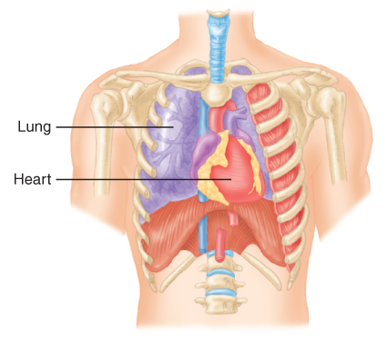
Check for Breathing and a Pulse (4 of 5)
FIGURE 14-7 The heart lies slightly to the left of the
middle of the chest between the sternum and spine.
© Jones & Bartlett Learning.
Notes:
The figure on this slide illustrates that the heart lies slightly to the left of the middle of the chest between the sternum and spine.

Slide 25
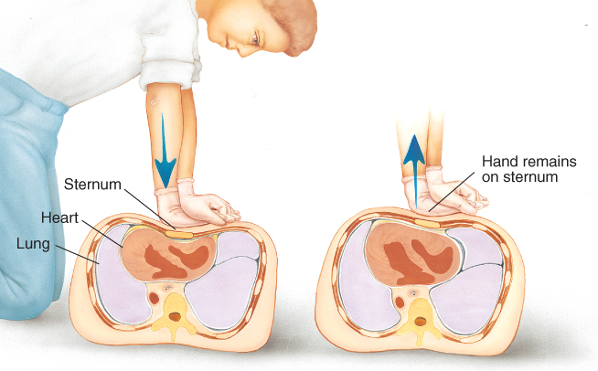
Check for Breathing and a Pulse (5 of 5)
FIGURE 14-8 A. Compression and relaxation should be rhythmic and of equal duration (a 1:1 ratio). B. Pressure on the sternum must be released so that the sternum can return to its normal resting position between compressions.
A, B: © Jones & Bartlett Learning. Courtesy of MIEMSS.
Notes:
The figure on this slide illustrates the concepts of compression and relaxation. A. Compression and relaxation should be rhythmic and of equal duration (a 1:1 ratio). B. Pressure on the sternum must be released so that the sternum can return to its normal resting position between compressions.

Slide 26
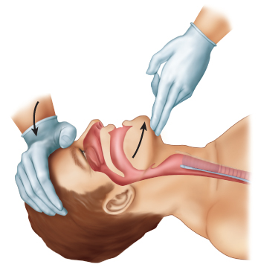
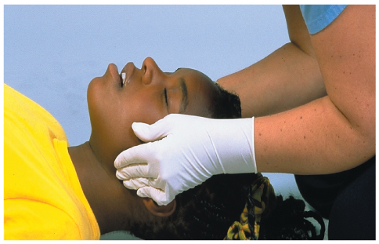
Opening the Airway and Providing
Artificial Ventilation (1 of 7)
Head tilt–chin lift maneuver
  Jaw-thrust maneuver
FIGURE 14-11 To perform the head tilt–chin lift maneuver, place one hand on the patient’s forehead and apply firm backward pressure with your palm to tilt the head back. Next, place the tips of the index and middle fingers of your other hand under the lower jaw near the bony part of the chin. Lift the chin upward, bringing the entire lower jaw
with it, helping to tilt the head back.
FIGURE 14-12 To perform the jaw-thrust maneuver, maintain the head in neutral alignment and place your fingers behind the angles of the lower jaw, and move the jaw upward.
© Jones & Bartlett Learning. Courtesy of MIEMSS.
© Jones & Bartlett Learning.
Notes:
Lecture Outline
VIII. Opening the Airway and Providing Artificial Ventilation
A. Opening the airway in adults
1. Head tilt–chin lift maneuver
a. Remove any foreign materials in the mouth.
2. Jaw-thrust maneuver

Slide 27
Opening the Airway and Providing
Artificial Ventilation (2 of 7)
If the patient is adequately breathing, and there are no signs injury to the head, spine, hip, or pelvis, place the patient in the recovery position.
  Maintains clear airway
  Allows vomitus to drain from mouth
  Roll the patient as a unit.
Notes:
Lecture Outline
B. If the patient is breathing adequately on his or her own and has no signs of injury to the head, spine, hip, or pelvis, place him or her in the recovery position.

Slide 28
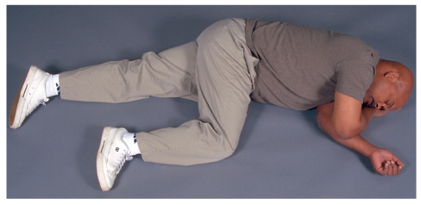
Opening the Airway and Providing
Artificial Ventilation (3 of 7)
Recovery position
FIGURE 14-13 The recovery position is used to maintain
an open airway in an adequately breathing patient with a
decreased level of consciousness who has no spinal injury.
It allows vomitus, blood, and any other secretions to drain
from the mouth.
© Jones & Bartlett Learning. Courtesy of MIEMSS.
Notes:
The figure on this slide demonstrates the recovery position.

Slide 29
Opening the Airway and Providing
Artificial Ventilation (4 of 7)
The combination of lack of oxygen and too much carbon dioxide in the blood is lethal.
If patient is not breathing, ventilations can be given by one or two EMS providers.
Use a barrier device.
Notes:
Lecture Outline
C. A lack of oxygen (hypoxia), combined with too much carbon dioxide in the blood (hypercarbia), is lethal.
1. Provide slow, deliberate ventilations that last 1 second.
D. If patient is not breathing, ventilations can be given by one or two EMS providers.
1. Use a barrier device, such as a pocket mask, one-way valve, or bag-mask device.
2. Use devices that supply supplemental oxygen when possible.

Slide 30
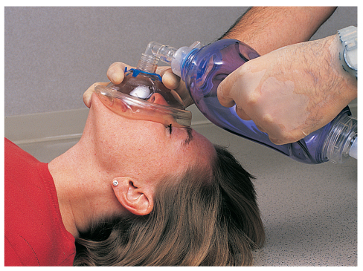
Opening the Airway and Providing
Artificial Ventilation (5 of 7)
FIGURE 14-14 When you provide ventilations, use a bag-mask device.
© Jones & Bartlett Learning. Courtesy of MIEMSS.
Notes:
The figure on this slide demonstrates using a barrier device when providing ventilations.

Slide 31
Opening the Airway and Providing
Artificial Ventilation (6 of 7)
For a patient with a stoma, place a bag-mask device or pocket mask device directly over the stoma.
Artificial ventilation may result in gastric distention.
Have a suction unit available in case patient vomits.
Notes:
Lecture Outline
E. For a patient with a stoma, place bag-mask device or pocket mask device directly over the stoma.
F. Artificial ventilation may result in gastric distention.
1. Have a suction unit available in case the patient vomits.

Slide 32
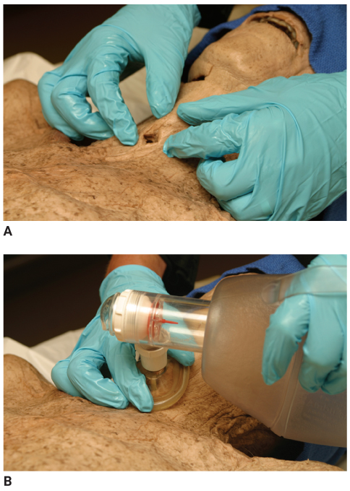
Opening the Airway and Providing
Artificial Ventilation (7 of 7)
FIGURE 14-15 A. This stoma connects the trachea directly to the skin. B. Use a bag-mask device to ventilate a patient with a stoma.
A, B: © Jones & Bartlett Learning. Courtesy of MIEMSS.
Notes:
The figures on this slide demonstrate how a barrier device attaches to a stoma. A. This stoma connects the trachea directly to the skin. B. Use a bag-mask device or pocket mask device to ventilate a patient with a stoma.

Slide 33
One-Rescuer Adult CPR
Single rescuer gives both chest compressions and artificial ventilations.
Ratio of compressions to ventilations is 30:2.
Notes:
Lecture Outline
IX. One-Rescuer Adult CPR
A. When providing CPR alone, you must provide a continuous cycle of 30 chest compressions followed by 2 artificial ventilations (see Skill Drill 14-2).
1. The ratio of compressions to ventilations is 30:2.

Slide 34
Two-Rescuer Adult CPR
Always preferable to one-rescuer CPR
  Less tiring
  Facilitates effective chest compressions
Switching rescuers during CPR is critical to maintain high-quality compressions.
  Recommended to switch positions every 2 minutes
Notes:
Lecture Outline
X. Two-Rescuer Adult CPR
A. Always preferable to one-rescuer CPR (see Skill Drill 13-3)
1. The rescuer who is doing the compressions can be switched.
a. Less tiring and facilitates effective chest compressions
B. Switching rescuers during CPR is critical to maintain high-quality compressions.
1. It is recommended to switch positions every 2 minutes.

Slide 35
Devices and Techniques to Assist Circulation (1 of 4)
Active compression-decompression CPR
  Involves compressing the chest and then actively pulling it back up to its neutral position
Impedance threshold device (ITD)
  Limits air entering lungs during recoil phase between chest compressions
Notes:
Lecture Outline
XI. Devices and Techniques to Assist Circulation
A. Active compression-decompression CPR
1. Involves compressing the chest and then actively pulling it back up to its neutral position or beyond
2. May increase the amount of blood that returns to the heart
B. Impedance threshold device (ITD)
1. Designed to limit the air entering lungs during the recoil phase between chest compressions

Slide 36
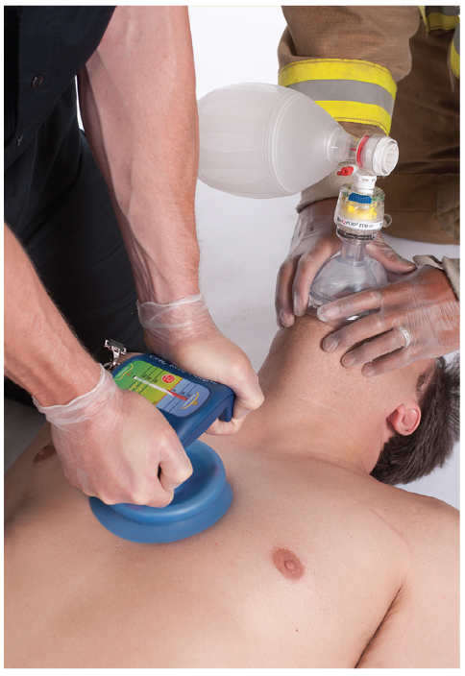
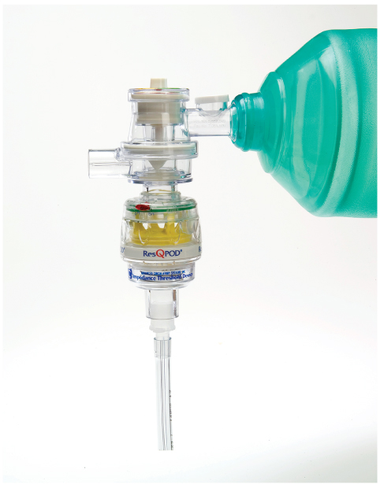
Devices and Techniques to Assist Circulation (2 of 4)
FIGURE 14-17 An active compression-decompression CPR device.
FIGURE 14-18 An impedance threshold device
Courtesy of Advanced Circulatory Systems, Inc.
Provided with permission by ZOLL Medical
Notes:
The first figure on this slide is an active compression-decompression CPR device. The second figure on this slide is an impedance threshold device.

Slide 37
Devices and Techniques to Assist Circulation (3 of 4)
Mechanical piston device
  Allows rescuer to configure the depth and rate of compression
Load-distributing band CPR or vest CPR
  A circumferential chest compression device composed of constricting band and backboard
Manual chest compressions remain the standard of care.
Notes:
Lecture Outline
C. Mechanical piston device
1. Allows the rescuer to configure the depth and rate of compressions.
D. Load-distributing band CPR or vest CPR
E. Manual chest compressions remain the standard of care.

Slide 38
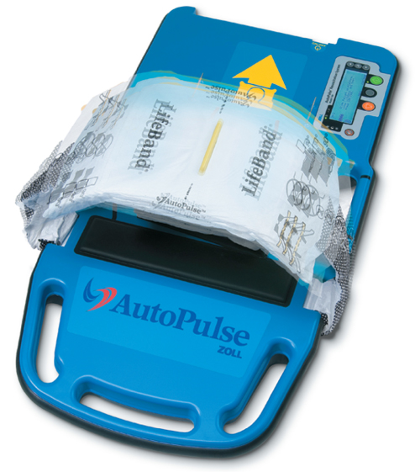
Devices and Techniques to Assist Circulation (4 of 4)
FIGURE 14-20 A load-distributing band.
Provided with permission by ZOLL Medical.
Notes:
The figure on this slide is a load-distributing band.

Slide 39
Infant and Child CPR (1 of 5)
Cardiac arrest in infants and children follows respiratory arrest.
  Airway and breathing are the focus of pediatric BLS.
Notes:
Lecture Outline
XII. Infant and Child CPR
A. In most cases, cardiac arrest in infants and children follows respiratory arrest, which triggers hypoxia and ischemia of the heart.
1. Airway and breathing are the focus of pediatric BLS.

Slide 40
Infant and Child CPR (2 of 5)
Causes of child respiratory problems:
  Injury
  Infections
  Foreign body
  Submersion
  Electrocution
  Poisoning/overdose
  SIDS
Notes:
Lecture Outline
B. Causes of respiratory problems leading to cardiopulmonary arrest in children:
1. Injury, both blunt and penetrating
2. Infections of the respiratory tract or another organ system
3. A foreign body in the airway
4. Submersion (drowning)
5. Electrocution
6. Poisoning or drug overdose
7. Sudden infant death syndrome (SIDS)

Slide 41
Infant and Child CPR (3 of 5)
Determine unresponsiveness.
  Gently tap on the shoulder and speak loudly.
Check for breathing and a pulse.
  Assessment occurs simultaneously.
  Should take no longer than 10 seconds
Notes:
Lecture Outline
C. Determining responsiveness
1. Gently tap child on shoulder and speak loudly.
a. If you find an unresponsive, apneic, pulseless child, while alone and off duty, perform CPR for 5 cycles (about 2 minutes) and then call the EMS system.
D. Check for breathing and a pulse
1. Palpate the brachial artery in infants
2. The infant or child must be lying on a hard, flat surface for effective chest compressions.
3. Only use two fingers to compress an infant’s chest.
4. If two rescuers are performing CPR on an infant, use the two-thumb-encircling-hands technique to deliver chest compressions.
5. In children, especially those older than 8 years, you can use the heel of one or both hands to compress the chest.
6. Follow the steps in Skill Drill 14-4 to perform infant chest compressions.
7. Follow the steps in Skill Drill 14-5 for performing CPR in children between 1 year and the onset of puberty.

Slide 42
Infant and Child CPR (4 of 5)
Foreign body obstruction in children is common.
  Place an unresponsive, breathing child in the recovery position.
The techniques for opening the airway are modified for pediatric patients.
Place a wedge under the upper chest and shoulders when supine.
Notes:
Lecture Outline
E. Airway
1. Foreign body obstruction in children is common.
a. Place an unresponsive, breathing child in the recovery position.
b. The two common techniques for manually opening an airway are modified for the pediatric patient.
c. Place a wedge of padding under a child’s upper chest and shoulders to avoid partially obstructing the airway.

Slide 43
Infant and Child CPR (5 of 5)
Provide rescue breathing.
Not breathing and has a pulse:
  1 breath every 2 to 3 seconds
Not breathing and no pulse:
  2 breaths after every 30 compressions
Notes:
Lecture Outline
F. Provide rescue breathing
1. If the child is not breathing but has a pulse, then open the airway and deliver one breath every 2 to 3 seconds (12 to 20 breaths/min).
2. If the child is not breathing and does not have a pulse, then deliver 2 rescue breaths after every 30 chest compressions (15 chest compressions if two rescuers are present).
3. If an infant or small child is breathing, then provide prompt transport.
a. Allow the child to stay in whatever position is most comfortable.
4. In a child with a tracheostomy tube in the neck, remove the mask from the bag-mask device and connect it directly to the tracheostomy tube to ventilate the child.
a. A face mask with one-way valve or other barrier device over the tracheostomy site can be used.

Slide 44
Interrupting CPR (1 of 2)
CPR is a crucial, life-saving procedure.
If no ALS available at scene:
  Provide transport per local protocols.
  Consider requesting ALS rendezvous en route to hospital.
Notes:
Lecture Outline
XIII. Interrupting CPR
A . CPR is a crucial, life-saving procedure that provides minimal circulation and ventilation until the patient can receive defibrillation, ALS treatment, and definitive care at the ED.
B. No matter how well performed, CPR is rarely enough to save a patient’s life.
C. If ALS is not available at the scene:
1. Provide transport based on your local protocols, continuing CPR on the way.
2. Consider requesting a rendezvous en route to hospital.

Slide 45
Interrupting CPR (2 of 2)
Try not to interrupt CPR for more than a few seconds.
Chest compression fraction
  The total percentage of time during a resuscitation attempt in which chest compressions are being performed
  Should be at least 60%
Notes:
Lecture Outline
D. Try not to interrupt CPR for more than a few seconds, except when necessary.
E. Chest compression fraction
1. The total percentage of time during a resuscitation attempt in which chest compressions are being performed
2. Try to maintain a chest compression fraction greater than 80%

Slide 46
When Not to Start CPR (1 of 3)
If the scene is not safe
If the patient has obvious signs of death
  Rigor mortis (stiffening of body)
  Dependent lividity (livor mortis)
  Putrefaction or decomposition of body
  Evidence of nonsurvivable injury
Notes:
Lecture Outline
XIV. When Not to Start CPR
A. Three general rules regarding when not to start CPR:
1. If the scene is unsafe
2. If the patient has obvious signs of death, which include an absence of pulse and breathing, along with any one of the following findings:
a. Rigor mortis—stiffening of the body after death
b. Dependent lividity (livor mortis)
c. Putrefaction—decomposition of the body
d. Evidence of nonsurvivable injury

Slide 47
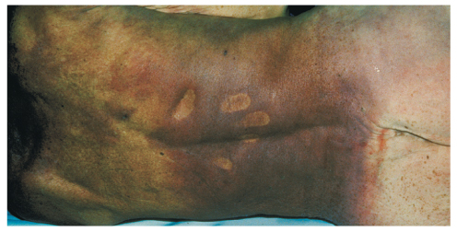
When Not to Start CPR (2 of 3)
Dependent lividity
FIGURE 14-25 Dependent lividity is an obvious sign of death, caused by blood settling to the areas of the body not in firm contact with the ground. The lividity in this figure is seen as purple discoloration of the back, except in areas that are in firm contact with the ground (scapula and buttock).
© American Academy of Orthopaedic Surgeons.
Notes:
The figure on this slide is an example of dependent lividity.

Slide 48
When Not to Start CPR (3 of 3)
If the patient and physician have previously agreed on do not resuscitate (DNR) orders:
  When in doubt, begin CPR.
Notes:
Lecture Outline
3. If the patient and physician have previously agreed on do not resuscitate (DNR) orders

Slide 49
When to Stop CPR
Once you begin CPR, continue until:
  S Patient Starts breathing and has a pulse.
  T Patient is Transferred to another provider of equal or higher-level training.
  O You are Out of strength.
  P Physician directs to discontinue.
Notes:
Lecture Outline
XV. When to Stop CPR
A. Once you begin CPR, continue until one of the following occur (using the mnemonic STOP):
1. S—Patient Starts breathing and has a pulse
2. T—Patient is Transferred to another provider of equal or higher-level training
3. O—You are Out of strength
4. P—Physician directs you to discontinue
B. “Out of strength” does not just mean tired, but physically unable to continue.

Slide 50
Foreign Body Airway Obstruction in Adults (1 of 7)
Airway obstruction may be caused by:
  Relaxation of throat muscles
  Vomited or regurgitated stomach contents
  Blood
  Damaged tissue
  Dentures
  Foreign bodies
Notes:
Lecture Outline
XVI. Foreign Body Airway Obstruction in Adults
A. Recognizing foreign body airway obstruction
1. Relaxation of the throat muscles in an unresponsive patient
2. Vomited or regurgitated stomach contents
3. Blood
4. Damaged tissue after an injury
5. Dentures
6. Foreign bodies such as food or small objects

Slide 51
Foreign Body Airway Obstruction in Adults (2 of 7)
In adults, usually occurs during a meal
In children, usually occurs during a meal or at play
Patient with mild airway obstruction is able to exchange air but with signs of respiratory distress.
Notes:
Lecture Outline
A. Recognizing foreign body airway obstruction
1. In adults, foreign body airway obstruction usually occurs during a meal.
2. In children, airway obstruction usually occurs during a meal or at play.
3. Mild airway obstruction
a. Patient is able to exchange adequate amounts of air but still has signs of respiratory distress
b. Leave these patients alone.
c. Observe for signs of a severe airway obstruction

Slide 52
Foreign Body Airway Obstruction in Adults (3 of 7)
Sudden, severe obstruction is usually easy to recognize in responsive patients.
In unresponsive patients, suspect obstruction if maneuvers to open airway and ventilate are ineffective.
Abdominal-thrust maneuver (Heimlich) is recommended in responsive adults and children older than 1 year.
Notes:
Lecture Outline
B. Responsive patients
1. A sudden, severe obstruction is usually easy to recognize in responsive patients.
a. The person is suddenly unable to speak or cough, grasps his or her throat, turns cyanotic, and makes exaggerated efforts to breathe.
b. Stridor may be present.
C. Unresponsive patients
1. In unresponsive patients, suspect obstruction if maneuvers to open airway and ventilate are ineffective.
D. Removing a foreign body airway obstruction in an adult
1. Abdominal-thrust maneuver (Heimlich maneuver) is recommended in responsive adults and children older than 1 year.
a. Creates an artificial cough
b. If the patient with a severe airway obstruction is unresponsive, then perform chest compressions.

Slide 53
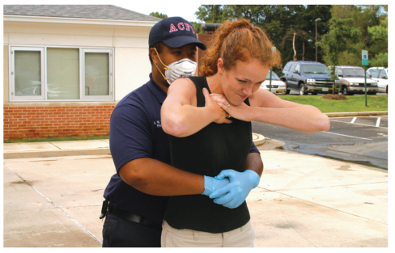
Foreign Body Airway Obstruction in Adults (4 of 7)
FIGURE 14-28 The abdominal thrust maneuver in a
responsive adult. Stand behind the patient and wrap your
arms around the patient’s abdomen. Place the thumb side
of one fist against the patient’s abdomen while holding
your fist with your other hand. Press your fists into the
patient’s abdomen, using inward and upward thrusts.
© Jones & Bartlett Learning. Courtesy of MIEMSS.
Notes:
The figure on this slide displays how to perform an abdominal-thrust maneuver in a responsive adult.

Slide 54
Foreign Body Airway Obstruction in Adults (5 of 7)
Instead of abdominal-thrust maneuver, use chest thrusts for the following responsive patients:
  Women in advanced stages of pregnancy
  Obese patients
Notes:
Lecture Outline
2. Instead of the abdominal-thrust maneuver, use chest thrusts for the following responsive patients:
a. Women in advanced stages of pregnancy
b. Obese patients

Slide 55
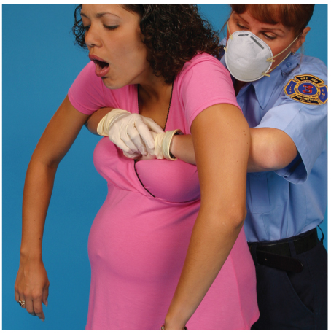
Foreign Body Airway Obstruction in Adults (6 of 7)
FIGURE 14-29 Removal of a foreign body obstruction in
a responsive adult using chest thrusts. Stand behind the
patient and wrap your arms around the patient’s chest.
Place the thumb side of one fist against the chest while
holding your fist with your other hand. Press your fists into
the patient’s chest with backward thrusts.
© Jones & Bartlett Learning. Courtesy of MIEMSS.
Notes:
The figure on this slide displays how to perform chest thrusts on a responsive adult.

Slide 56
Foreign Body Airway Obstruction in Adults (7 of 7)
Unresponsive patients:
  Determine unresponsiveness.
  Check for breathing and a pulse.
  If pulse is present and breathing is absent, attempt ventilation.
  If two attempts do not produce visible chest rise, perform 30 compressions, open airway, and look in mouth.
    Attempt to carefully remove any visible object.
Notes:
Lecture Outline
E. Responsive patients who become unresponsive
1. Lower the patient to the ground and call for help (or send someone for help).
2. Perform 30 chest compressions.
a. Do not check for a pulse before beginning chest compressions.
3. Open the airway and look in the mouth.
a. If you see an object that can be easily removed, remove it with your fingers and attempt to ventilate.
b. If you do not see any object, resume chest compressions.
4. Repeat steps 2 and 3 until the obstruction is relieved or ALS providers take over.
F. Unresponsive patients
1. Determine unresponsiveness and check for breathing and a pulse simultaneously.
2. If pulse is present but breathing is absent, then open the airway and attempt to ventilate.
a. If the first ventilation does not produce visible chest rise, then reposition the airway and reattempt to ventilate.
3. If both ventilation attempts do not produce visible chest rise, then perform 30 compressions, open the airway, and look in the mouth.
a. Attempt to carefully remove any visible object.

Slide 57
Foreign Body Airway Obstruction in
Infants and Children (1 of 5)
Common problem
If there are signs and symptoms of airway obstruction, do not waste time trying to dislodge a foreign body.
On responsive, standing or sitting child, perform Heimlich maneuver.
On unresponsive child older than 1 year, manage in the same manner as an adult.
Notes:
Lecture Outline
XVII. Foreign Body Airway Obstruction in Infants and Children
A. Airway obstruction is a common problem in infants and children.
B. In patients who have signs and symptoms of an airway obstruction, do not waste time trying to dislodge a foreign body.
1. Administer supplemental oxygen if needed and immediately transport the child to the ED.
C. As long as the patient can breathe, cough, or talk, do not interfere with his or her attempts to expel the foreign body.
1. Administer supplemental oxygen if needed (and tolerated) and provide transport to the ED.
D. On a responsive standing or sitting child, perform the Heimlich maneuver but with less force than what would be used on an adult.
E. An unresponsive child older than 1 year who has an airway obstruction is managed in the same manner as an adult (see Skill Drill 14-6).

Slide 58
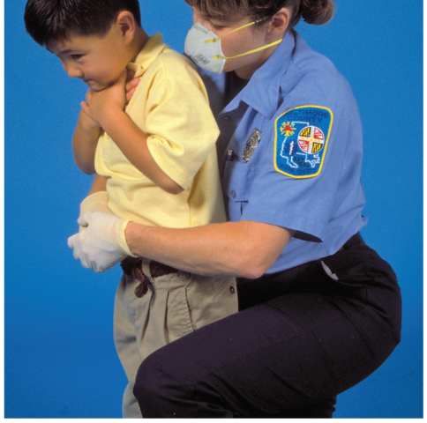
Foreign Body Airway Obstruction in
Infants and Children (2 of 5)
FIGURE 14-31 To perform the abdominal thrust maneuver
on a child, kneel behind the child on one knee, wrap your
arms around the child’s body, and place your fist just above
the umbilicus and well below the lower tip of the sternum
© Jones & Bartlett Learning. Courtesy of MIEMSS.
Notes:
The figure on this slide demonstrates how to perform the abdominal-thrust maneuver on a responsive child.

Slide 59
Foreign Body Airway Obstruction in
Infants and Children (3 of 5)
Responsive infants
  Do not use abdominal thrusts.
  Perform back slaps and chest thrusts (compressions).
Notes:
Lecture Outline
F. Responsive infants
1. Perform back slaps and chest thrusts (compressions).

Slide 60
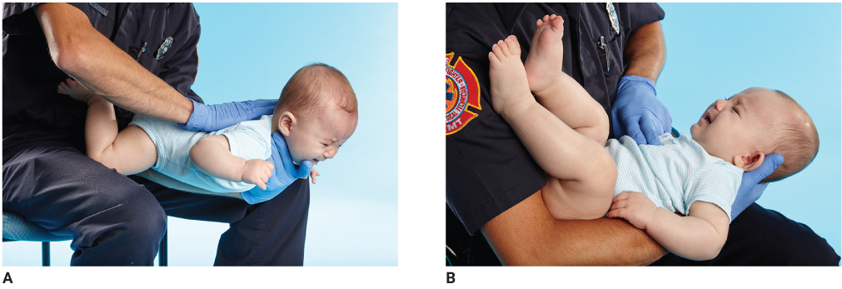
Foreign Body Airway Obstruction in
Infants and Children (4 of 5)
FIGURE 14-32 A. Hold the infant facedown with the body resting on your forearm. Support the jaw and face with your hand and keep the head lower than the rest of the body. Give the infant five back slaps between the shoulder blades, using the heel of your hand. B. Give the infant five quick chest thrusts, using two fingers placed on the lower half of the sternum.
A, B: © Jones & Bartlett Learning.
Notes:
The figures on this slide demonstrate how to perform back blows and chest thrusts on an infant. A. Hold the infant face down with the body resting on the forearm. Support the jaw and face with your hand and keep the head lower than the rest of the body. Give the infant five back blows between the shoulder blades, using the heel of your hand. B. Give the infant five quick chest thrusts, using two fingers placed on the lower half of the sternum.

Slide 61
Foreign Body Airway Obstruction in
Infants and Children (5 of 5)
In unresponsive infants, begin CPR, beginning with chest compressions.
Do not check for a pulse before starting compressions.
Open the airway and look in the mouth.
  Remove the object if seen.
  Resume chest compressions if no object is seen.
Notes:
Lecture Outline
G. In unresponsive infants, begin CPR beginning with chest compressions.
1. Do not check for a pulse before starting compressions.
2. Open the airway and look in the mouth.
a. If you see an object that can be easily removed, then remove it with your finger and attempt to ventilate.
b. If you do not see an object, then resume chest compressions.
3. Continue the sequence of chest compressions, opening the airway, and looking inside the mouth until the obstruction is relieved or ALS providers take over.

Slide 62
Special Resuscitation Circumstances
Opioid overdose
  Standard resuscitation measures take priority over naloxone administration.
Cardiac arrest in pregnancy
  Priorities are to provide high-quality CPR and relieve pressure off the aorta and vena cava.
Notes:
Lecture Outline
XVIII. Special Resuscitation Circumstances
A. Opioid overdose
1. EMTs may be allowed to administer naloxone (Narcan) to reverse the arrest.
B. Cardiac arrest in pregnancy
1. Priorities are to provide high-quality CPR and relieve pressure off the aorta and vena cava
2. If the pregnant patient is not in cardiac arrest, then position her on her left side to relieve pressure on the great vessels.
3. If she is in cardiac arrest, and the top of the patient’s uterus can be felt at or above the level of the umbilicus, perform manual displacement of the uterus to the patient’s left to relieve aortocaval compression while CPR is being performed.

Slide 63
Grief Support for Family Members and
Loved Ones (1 of 3)
Family members may experience a psychologic crisis that turns into a medical crisis.
Family members and loved ones will remember this event in detail for the rest of their lives.
Keep the family informed throughout the resuscitation process.
Notes:
Lecture Outline
XVIX. Grief Support for Family Members and Loved Ones
A. Family members may experience a psychologic crisis that turns into a medical crisis.
B. Family members and loved ones will remember this event in detail for the rest of their lives.
1. Appropriate and supportive care at the onset of grief may positively affect the family’s grieving process.
C. Keep the family informed throughout the resuscitation process.
1. Designate one provider to communicate the patient’s status to family members.
2. Be concise and clear.

Slide 64
Grief Support for Family Members and
Loved Ones (2 of 3)
After resuscitation has stopped, helpful measures include:
  Take the family to a quiet, private place.
  Use clear language and speak in a warm, sensitive, and caring manner.
  Exhibit calm, reassuring authority.
  Use the patient’s name.
  Use eye contact and appropriate touch.
Notes:
Lecture Outline
D. After resuscitation has stopped, these other measures can be helpful:
1. Take the family to a quiet, private place.
2. Introduce yourself and anyone with you.
3. Use clear language and speak in a warm, sensitive, and caring manner.
4. Try to exhibit calm, reassuring authority.
5. Use the patient’s name.
6. Use eye contact and appropriate touch.

Slide 65
Grief Support for Family Members and
Loved Ones (3 of 3)
After resuscitation has stopped, helpful measures include (cont’d):
  Expect emotion.
  Be supportive but do not hover.
  Ask if a friend or family member can be called.
Ensure that children are not ignored.
Notes:
Lecture Outline
7. Expect that family members will show emotion as they begin the grieving process.
8. While you are still on scene, be supportive but do not hover.
9. Ask if a friend or family member can be called to come and help support them.
10. When you need to leave, turn the family over to someone
E. Ensure that children are not ignored.
F. See Chapter 2, Workforce Safety and Wellness, for a discussion of the emotional aspects of emergency care and stress management.

Slide 66
Education and Training for the EMT
CPR skills can deteriorate over time.
  Practice often using manikin-based training.
  CPR self-instruction through a video and/or computer-based modules with hands-on practice.
Notes:
Lecture Outline
XX. Education and Training for the EMT
A. CPR skills can deteriorate over time.
1. Practice often using manikin-based training.
2. CPR self-instruction through a video and/or computer-based modules with hands-on practice may be a reasonable alternative to instructor-led courses.

Slide 67
Education and Training for the Public
You are a patient advocate.
You must do your part to facilitate the training of laypeople in the critical skills of CPR and AED operation.
Notes:
Lecture Outline
XXI. Education and Training for the Public
A. You are a patient advocate.
1. Not only are you responsible for providing the best possible care for your patient, but you must do your part to facilitate the training of laypeople in the critical skills of CPR and AED operation.
2. If you are asked to train members of your community how to perform compression-only CPR, then you should consider it your professional responsibility and be willing to assist.

Slide 68
Review
Brain damage is very likely in a brain that does not receive oxygen for:
  0–1 minutes.
  0–4 minutes.
  4–6 minutes.
  6–10 minutes.

Slide 69
Review
Answer: D
Rationale: Permanent brain damage is very likely if the brain is without oxygen for 6 minutes or longer. After 10 minutes without oxygen, irreversible brain damage is likely.

Slide 70
Review
Brain damage is very likely in a brain that does not receive oxygen for:
  0–1 minutes.
  Rationale: Cardiac irritability ensues at this stage.
  0–4 minutes.
  Rationale: Brain damage is not likely at this stage.
  4–6 minutes.
  Rationale: Brain damage is possible at this stage, but not likely.
  6–10 minutes.
  Rationale: Correct answer

Slide 71
Review
Which of the following sequences of events describes the AHA chain of survival?
  Early access, integrated post-arrest care, early advanced care, early CPR, early defibrillation, recovery
  Early advanced care, early defibrillation, integrated post-arrest care, early CPR, early access
  Early access, early CPR, early defibrillation, early advanced care, integrated post-arrest care, recovery
  Early access, early riser, early CPR, early advanced care

Slide 72
Review
Answer: C
Rationale: The AHA has determined an ideal sequence of events that, if taken, can improve the chance of successful resuscitation of a patient who has an occurrence of sudden cardiac arrest: early access, early CPR, early defibrillation, early advanced care, integrated post-arrest care, and a recovery plan. If any one of the links in the chain is absent, the patient is more likely to die.

Slide 73
Review
Which of the following sequences of events describes the AHA chain of survival?
  Early access, integrated post-arrest care, early advanced care, early CPR, early defibrillation, recovery
  Rationale: Early CPR and defibrillation come before advanced care.
  Early advanced care, early defibrillation, integrated post-arrest care, early CPR, early access
  Rationale: Chain is backwards.
  Early access, early CPR, early defibrillation, early advanced care, integrated post-arrest care, recovery
  Rationale: Correct answer
  Early access, early riser, early CPR, early advanced care
  Rationale: Early riser is not in the chain of events.

Slide 74
Review
For CPR to be effective, the patient must be on a firm surface, lying in the ______________ position.
  Fowler
  prone
  supine
  recovery

Slide 75
Review
Answer: C
Rationale: For CPR to be effective, the patient must be lying supine on a firm surface, with enough clear space around the patient for two rescuers to perform CPR. If the patient is crumpled up or lying face down, you will need to reposition him or her. The few seconds that you spend repositioning the patient properly will greatly improve the delivery and effectiveness of CPR.

Slide 76
Review
For CPR to be effective, the patient must be on a firm surface, lying in the ______________ position.
  Fowler
  Rationale: The patient is sitting up with knees bent in this position, making it nearly impossible to make effective chest compressions.
  prone
  Rationale: The patient is lying facedown in this position.
  supine
  Rationale: Correct answer
  recovery
  Rationale: The patient is lying facedown with one knee bent and the head slightly tilted.

Slide 77
Review
The pulse check should take:
  1 second.
  at least 1 second but no more than 5 seconds.
  at least 10 seconds.
  at least 5 seconds but no more than 10 seconds.

Slide 78
Review
Answer: D
Rationale: The pulse check should take at least 5 seconds but no more than 10 seconds.

Slide 79
Review
The pulse check should take:
  1 second.
  Rationale: One second is not long enough to detect a pulse.
  at least 1 second but no more than 5 seconds.
  Rationale: Five seconds may not be long enough to detect a pulse.
  at least 10 seconds.
  Rationale: Ten seconds is a long time in this situation. The brain should not be deprived of oxygen for longer than 6 minutes. Every second counts.
  at least 5 seconds but no more than 10 seconds.
  Rationale: Correct answer

Slide 80
Review
Artificial ventilation may result in the stomach becoming filled with air, a condition called:
  gastric distention.
  vomitus.
  abdominal-thrust maneuver.
  acute abdomen.

Slide 81
Review
Answer: A
Rationale: Artificial ventilation may result in the stomach becoming filled with air, a condition called gastric distention. Gastric distention is likely to occur if you ventilate too fast, if you give too much air, or if the airway is not opened adequately. Therefore, it is important for you to give slow, gentle breaths.

Slide 82
Review
Artificial ventilation may result in the stomach becoming filled with air, a condition called:
  gastric distention.
  Rationale: Correct answer
  vomitus.
  Rationale: Gastric distention may lead to vomitus.
  abdominal-thrust maneuver.
  Rationale: The abdominal-thrust maneuver is a method of removing a foreign obstruction from an airway.
  acute abdomen.
  Rationale: Acute abdomen is a medical term referring to the sudden onset of abdominal pain, generally associated with severe, progressive problems that require medical attention.

Slide 83
Review
The ______________ is a circumferential chest compression device composed of a constricting band and backboard.
  mechanical piston device
  load-distributing band
  impedance threshold device
  cardiopulmonary resuscitation

Slide 84
Review
Answer: B
Rationale: The load-distributing band is a circumferential chest compression device composed of a constricting band and backboard. The device is either electronically or pneumatically driven to compress the heart by putting inward pressure on the thorax. As with the mechanical piston device, use of the device frees the rescuer to complete other tasks. It is lighter and easier to apply than the mechanical piston device.

Slide 85
Review
The ______________ is a circumferential chest compression device composed of a constricting band and backboard.
  mechanical piston device
  Rationale: This device depresses the sternum via a compressed gas-powered plunger mounted on a backboard.
  load-distributing band
  Rationale: Correct answer
  impedance threshold device
  Rationale: This valve device is placed between the endotracheal tube and a bag-mask device. It is designed to limit the air entering the lungs during the recoil phase.
  cardiopulmonary resuscitation
  Rationale: This procedure is used to establish artificial ventilation and circulation in a patient who is not breathing and has no pulse.

Slide 86
Review
Which of the following scenarios would warrant an interruption in CPR procedures?
  A hysterical family member trying to gain access to the unconscious patient
  A vehicle honking its horn anxious to pass by the scene on a blocked road
  A small set of steps leading to the exit of the building, on the way to the ambulance
  Being tired from trying to resuscitate a patient

Slide 87
Review
Answer: C
Rationale: Try not to interrupt CPR for more than a few seconds, except when it is absolutely necessary. For example, if you have to move a patient up or down stairs, you should continue CPR until you arrive at the head or foot of the stairs, interrupt CPR at an agreed-on signal, and move quickly to the next level where you can resume CPR.

Slide 88
Review (1 of 2)
Which of the following scenarios would warrant an interruption in CPR procedures?
  A hysterical family member trying to gain access to the unconscious patient
  Rationale: Family members should be calmed down and reassured that the patient is in good hands. A hysterical family member does not warrant a break in CPR.
  A vehicle honking its horn anxious to pass by the scene on a blocked road
  Rationale: Your primary focus should be on the patient. Let the on-scene police and/or traffic control deal with upset motorists and blocked roadways.

Slide 89
Review (2 of 2)
Which of the following scenarios would warrant an interruption in CPR procedures?
  A small set of steps leading to the exit of the building, on the way to the ambulance
  Rationale: Correct answer.
  Being out of breath while trying to resuscitate a patient
  Rationale: CPR should always be continued until the patient’s care is transferred to a physician in a hospital setting. Being “out of breath” does not mean being physically incapable of performing more CPR.

Slide 90
Review
Once you begin CPR in the field, you must continue until one of the following events occurs:
  The patient stops breathing and has no pulse.
  The patient is transferred to another person who is trained in BLS, to ALS-trained personnel, or to another emergency medical responder.
  You are out of gas in the ambulance.
  A police officer assumes responsibility for the patient and gives direction to discontinue CPR.

Slide 91
Review
Answer: B
Rationale: The “T” in the “STOP” mnemonic stands for patient transfer to another person who is trained in BLS, to ALS-trained personnel, or to another emergency medical responder.

Slide 92
Review
Once you begin CPR in the field, you must continue until one of the following events occurs:
  The patient stops breathing and has no pulse
  Rationale: These are reasons to begin CPR.
  The patient is transferred to another person who is trained in BLS, to ALS-trained personnel, or to another emergency medical responder
  Rationale: Correct answer
  You are out of gas in the ambulance
  Rationale: This is not a valid reason to stop CPR. You are out of strength or too tired to continue may be a valid reason.
  A police officer assumes responsibility for the patient and gives direction to discontinue CPR
  Rationale: A physician who is present or providing online medical direction should assume responsibility for the patient and give direction to discontinue CPR.

Slide 93
Review
Instead of the abdominal-thrust maneuver, use ___________ for women in advanced stages of pregnancy and patients who are obese.
  chest thrusts
  Sellick maneuver
  basic life support
  DNR orders

Slide 94
Review
Answer: A
Rationale: You can perform the abdominal-thrust maneuver safely on all adults and children. However, for women in advanced stages of pregnancy and patients who are obese, you should use chest thrusts.

Slide 95
Review
Instead of the abdominal-thrust maneuver, use ___________ for women in advanced stages of pregnancy and patients who are obese.
  chest thrusts
  Rationale: Correct answer
  Sellick maneuver
  Rationale: This technique is used to prevent gastric distention in which pressure is applied to the cricoid cartilage; also referred to as cricoid pressure.
  basic life support
  Rationale: BLS is noninvasive emergency life-saving care that is used to treat medical conditions. Chest thrusts are a BLS tactic.
  DNR orders
  Rationale: Do not resuscitate orders are specific instructions not to perform life-saving techniques on certain patients who may be suffering from terminal illnesses. DNR orders must be on hand and can be a complicated issue.

Slide 96
Review
In infants who have signs and symptoms of an airway infection, you should not waste time trying to dislodge a foreign body. You should intervene only if signs of ____________ develop, such as a weak, ineffective cough; cyanosis; stridor; absent air movement; or a decreasing level of consciousness.
  sudden infant death syndrome
  child abuse
  bronchitis
  severe airway obstruction

Slide 97
Review
Answer: D
Rationale: With a mild airway obstruction, the patient can cough forcefully, although there may be wheezing between coughs. As long as the patient can breathe, cough, or talk, you should not interfere with his or her attempts to expel the foreign body. As with an adult, encourage the child to continue coughing. Administer 100% oxygen with a nonrebreathing mask and provide transport to the emergency department.

Slide 98
Review (1 of 2)
In infants who have signs and symptoms of an airway infection, you should not waste time trying to dislodge a foreign body. You should intervene only if signs of ____________ develop, such as a weak, ineffective cough, cyanosis, stridor, absent air movement, or a decreasing level of consciousness.
  sudden infant death syndrome
  Rationale: Death of an infant or young child that remains unexplained after a complete autopsy.
  child abuse
  Rationale: The obstruction may be the result of child abuse, but these signs are those of a severe airway obstruction.

Slide 99
Review (2 of 2)
In infants who have signs and symptoms of an airway infection, you should not waste time trying to dislodge a foreign body. You should intervene only if signs of ____________ develop, such as a weak, ineffective cough, cyanosis, stridor, absent air movement, or a decreasing level of consciousness.
  bronchitis
  Rationale: This is an inflammation of the lung. It is not the direct result of a foreign body lodged in the airway.
  severe airway obstruction
  Rationale: Correct answer

